Slide 1
MATH 511
Numerial Solution of Partial Differential Equations
A Great and Enjoyable Class!!!!
WELCOME

Slide 2
BYU Mission
The mission of Brigham Young University founded, supported, and guided by The Church of Jesus Christ of Latter-day Saints is
“To assist individuals in their quest for perfection and eternal life. “

Slide 3
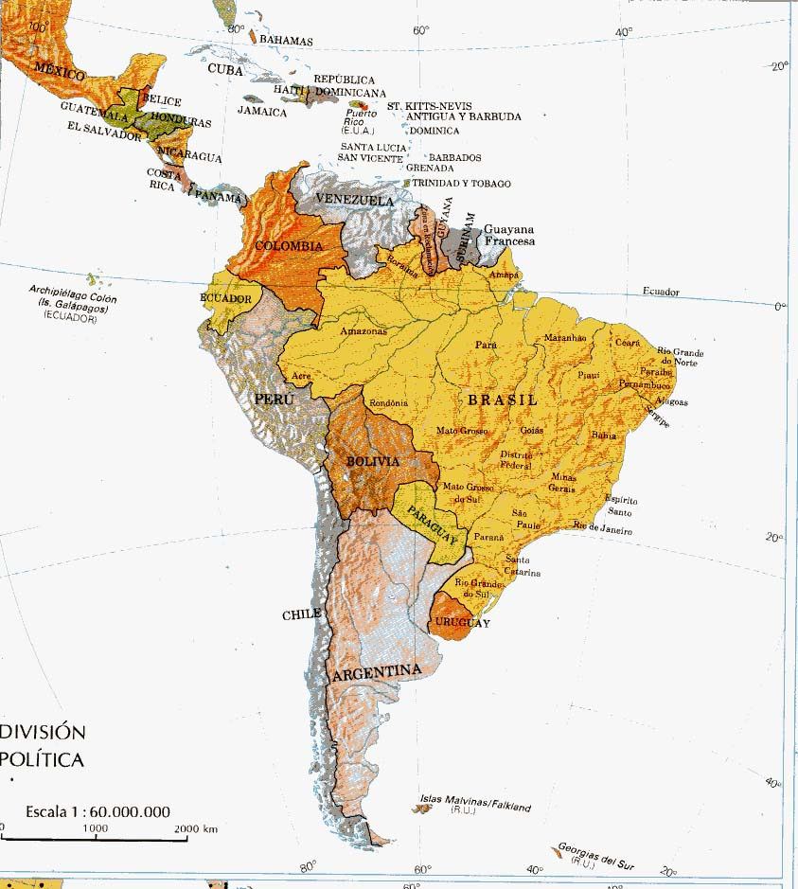
South
America

Slide 4
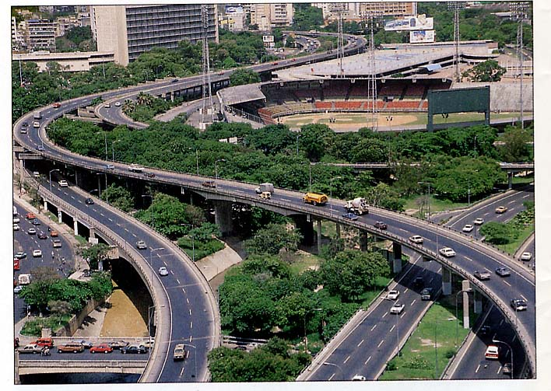
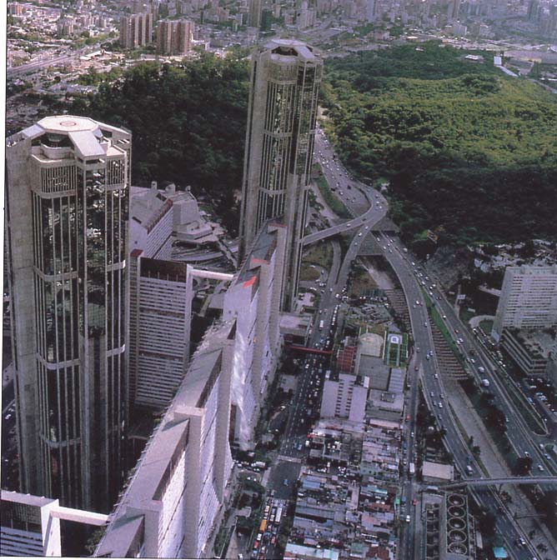
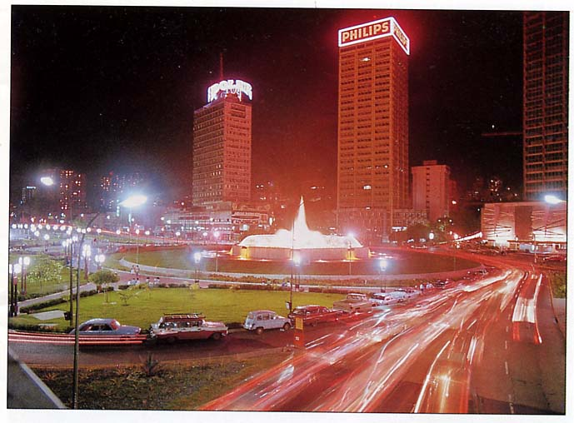

Slide 5
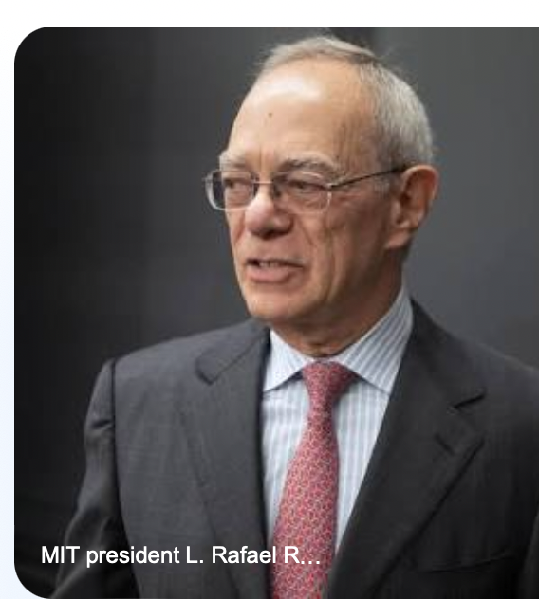
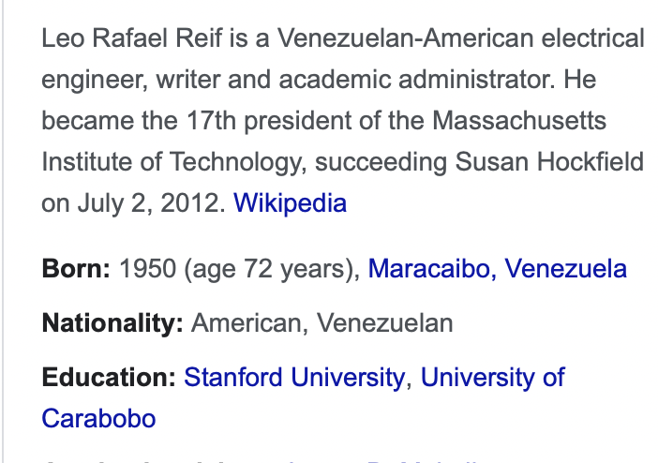

Slide 6
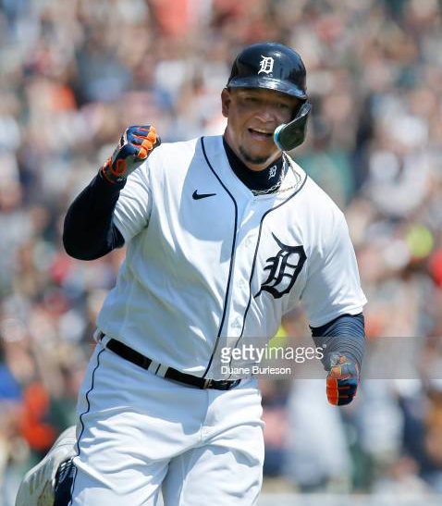
Miguel Cabrera is not only one of the greatest Venezuelan MLB players of all time but is one of the greatest in MLB history. One of the best pure hitters of his generation, Cabrera has enjoyed an incredibly successful major league career.

Slide 7
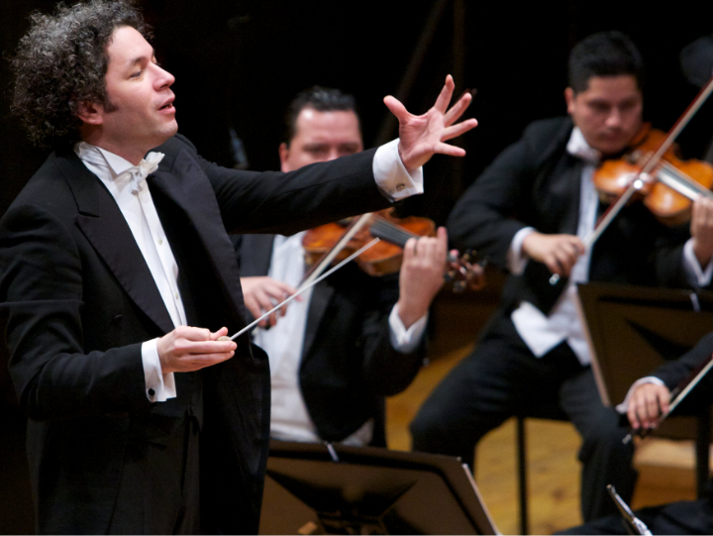
Gustavo Dudamel, (born January 26, 1981, Barquisimeto, Venezuela), Venezuelan conductor and music director of the Los Angeles Philharmonic Orchestra (2009– ) who earned acclaim for his ability to draw fresh dynamic performances from orchestras. Driven by an unwavering belief in the power of music to heal, unite, and inspire, Gustavo Dudamel is one of the most distinguished conductors of our day.

Slide 8
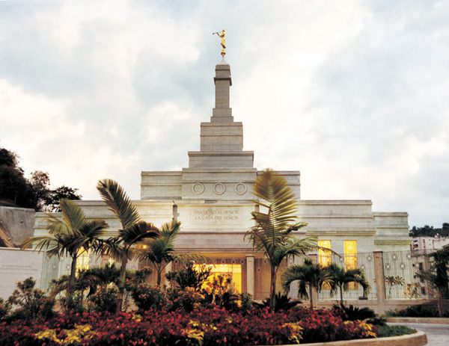
Caracas, Venezuela Temple

Slide 9
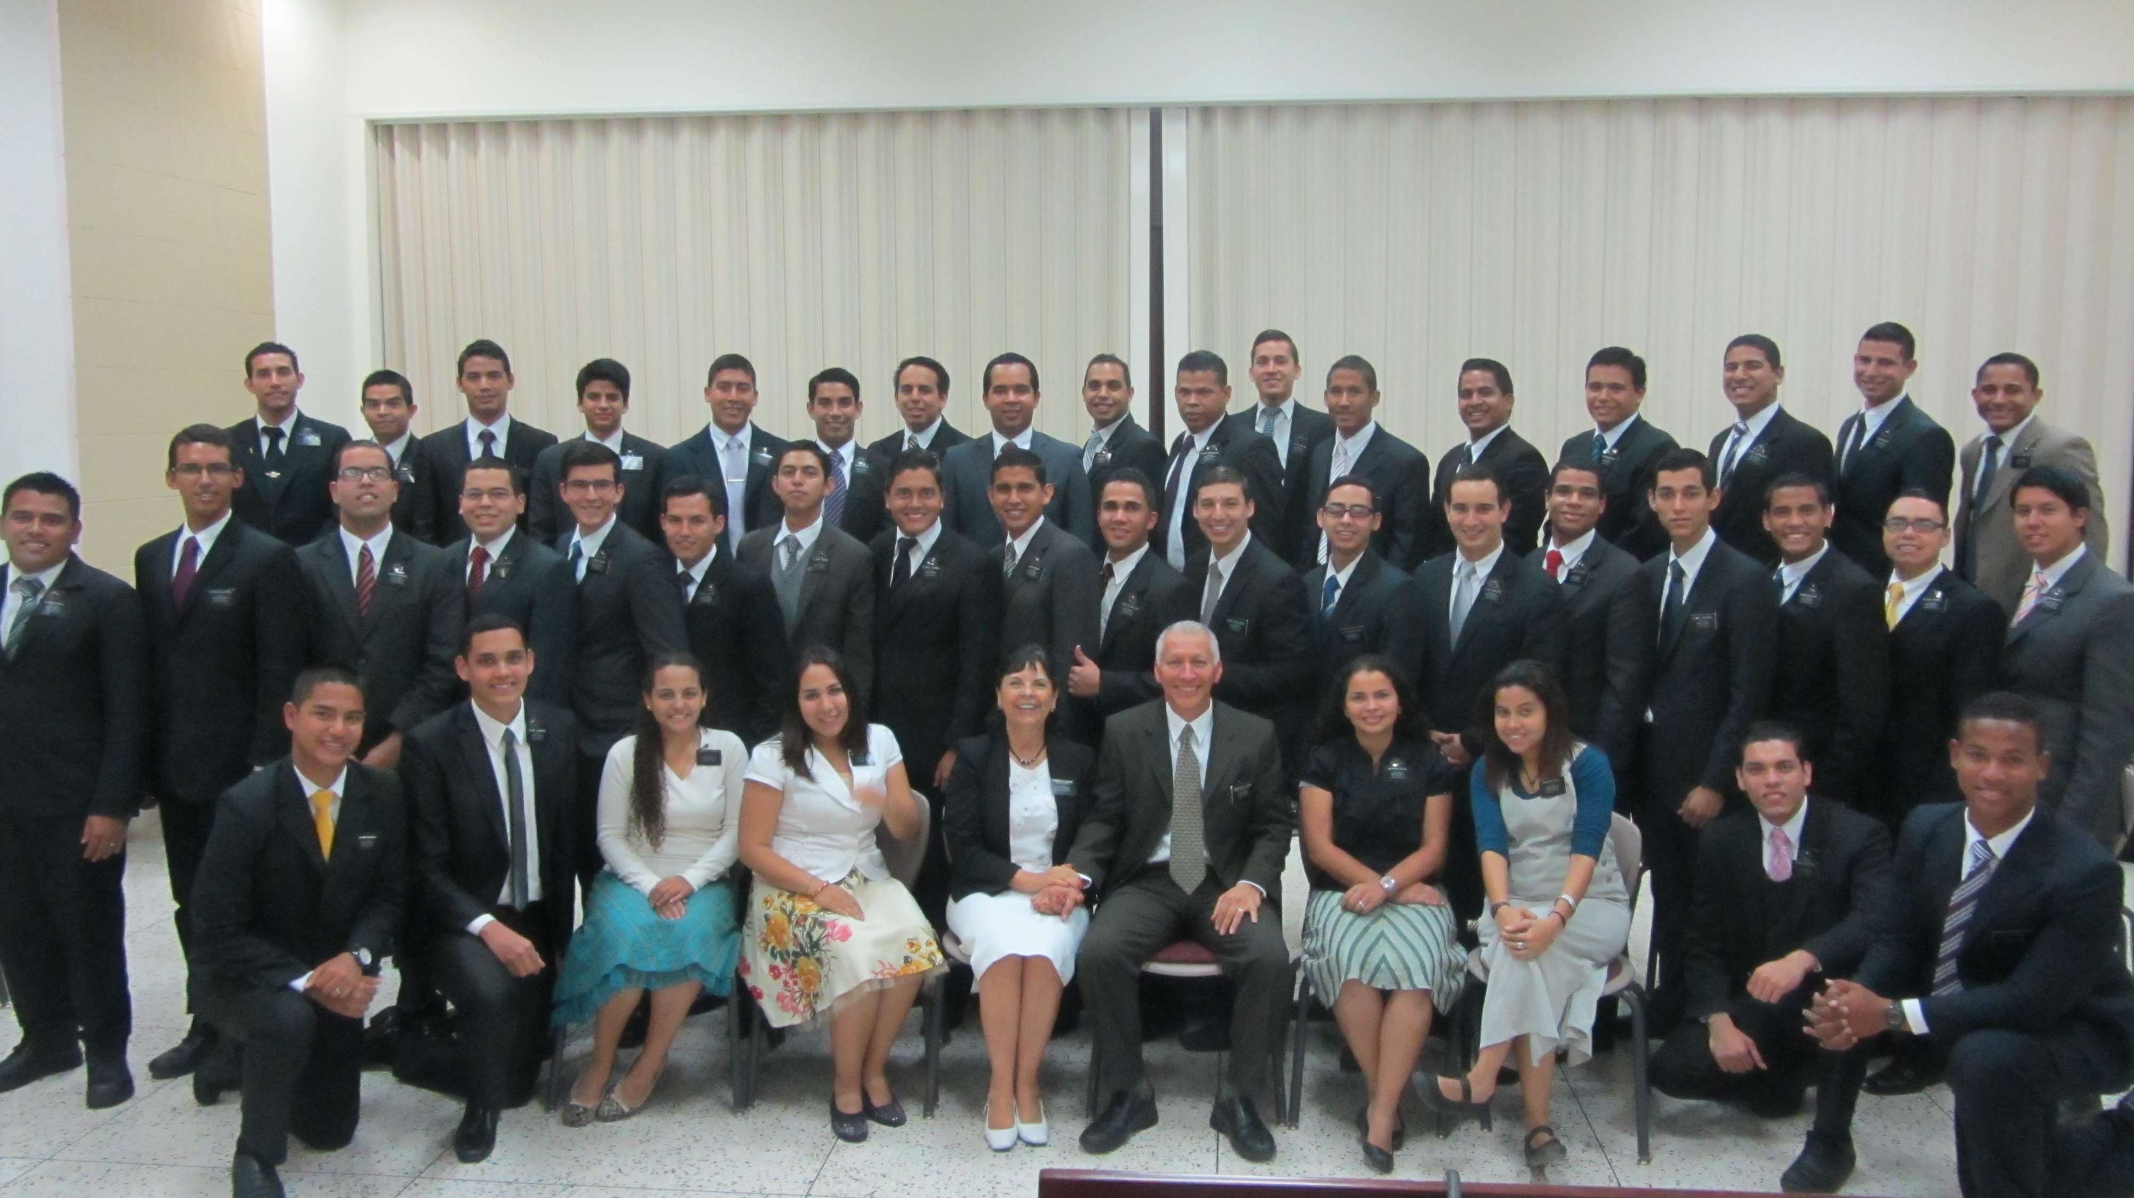
Venezuela, Caracas Mission
2011-2014

Slide 10
Education and Experience
EDUCATION
Bs, Ms Universidad Central de Venezuela (Caracas, Venezuela)
PhD Rensselaer Polytechnic Institute (Troy, New York)
TEACHING AND RESEARCH
Rensselaer Polytechnic Institute (1 year)
Northwestern University, Evanston, Illinois (2 years)
Universidad Central de Venezuela (10+ years)
New Jersey Institute of Technology, Newark, New Jersey (1 year)
Brigham Young University (23 years)
King Abdullah University of Sciences and Technology, Saudi Arabia (1 Semester)
Barcelona Super-Computing Center, Barcelona, Spain (1 Semester)

Slide 11
Education and Experience
At BYU, I have taught:
Math 334. Ordinary Differential Equs.
Math 410, 411. Num. Analysis
Math 314. Multivariable Calculus.
Math 511. Num. Soln. Of Partial Diff. Equs
Math 313. Elementary Linear Algebra
Math 521. Methods in Applied Mathematics
Research interest:
Numerical and Asymptotic Methods Applied to Linear and Nonlinear Partial Differential and Integral Equations
Wave Propagation: Acoustic, Electromagnetic, and Elastic Scattering.

Slide 12
        Meet My Family

Slide 13
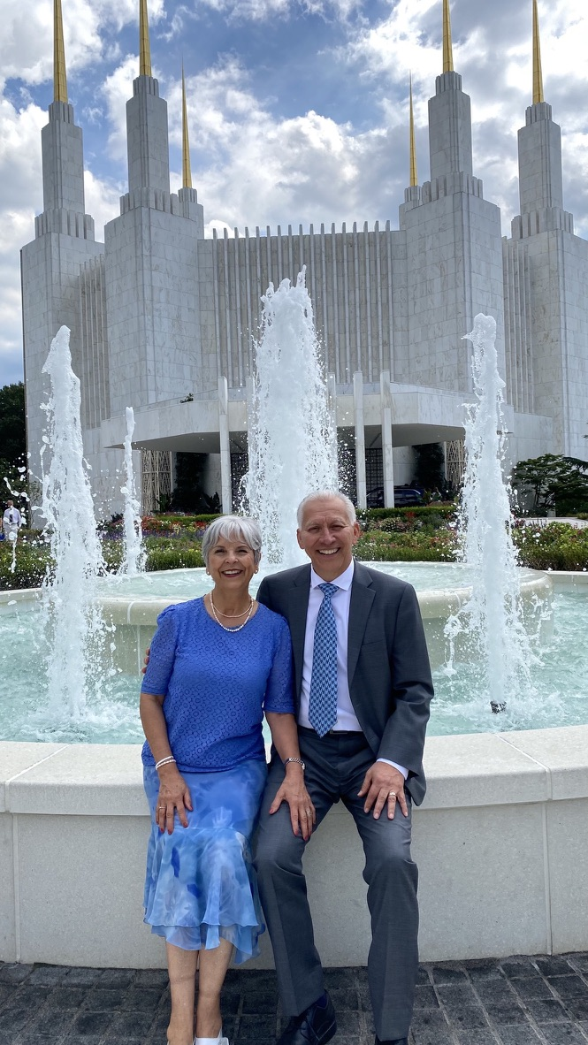

Slide 14
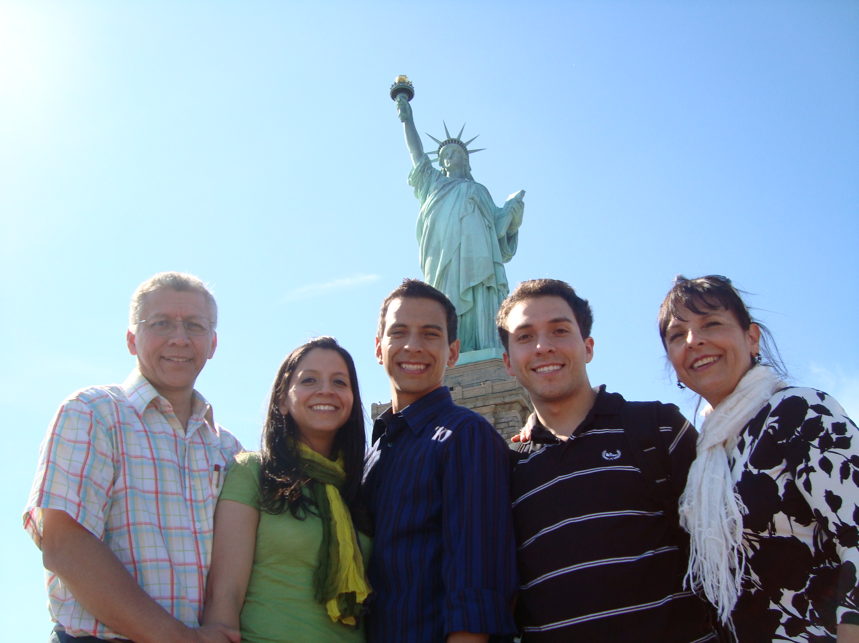

Slide 15
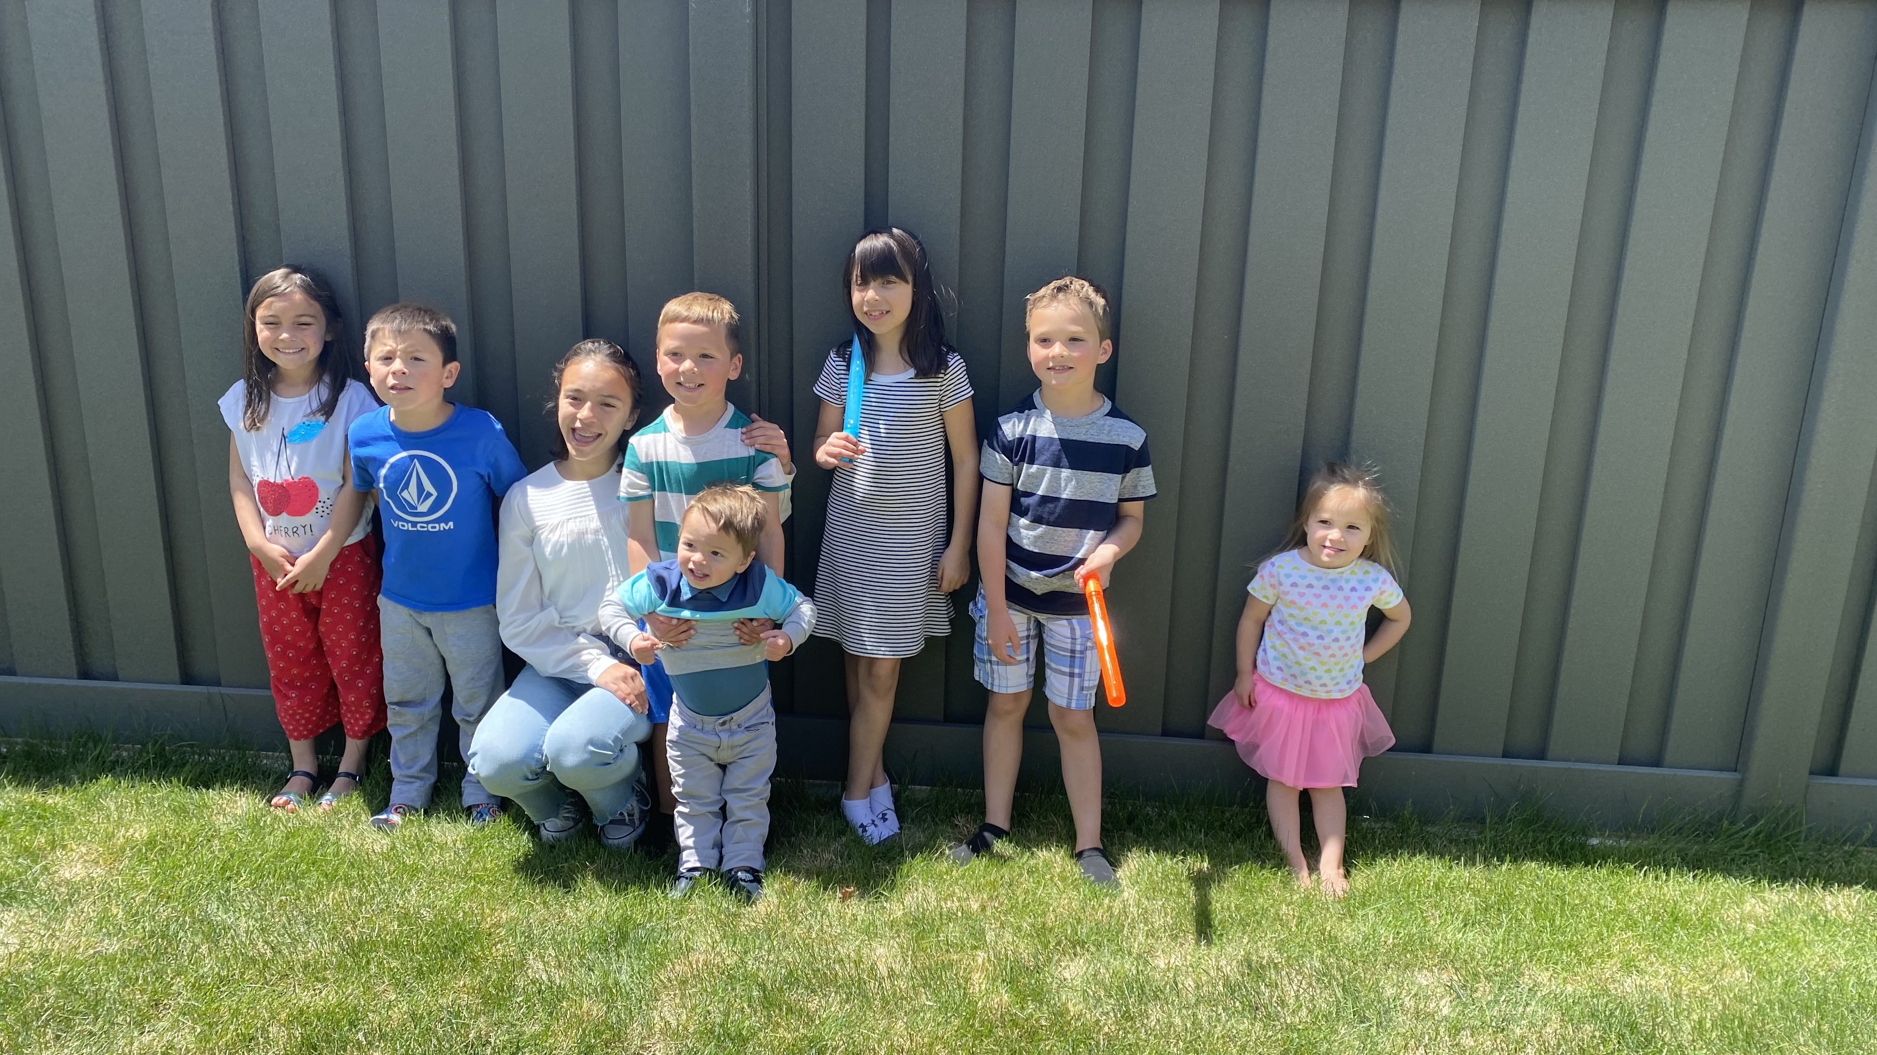

Slide 16
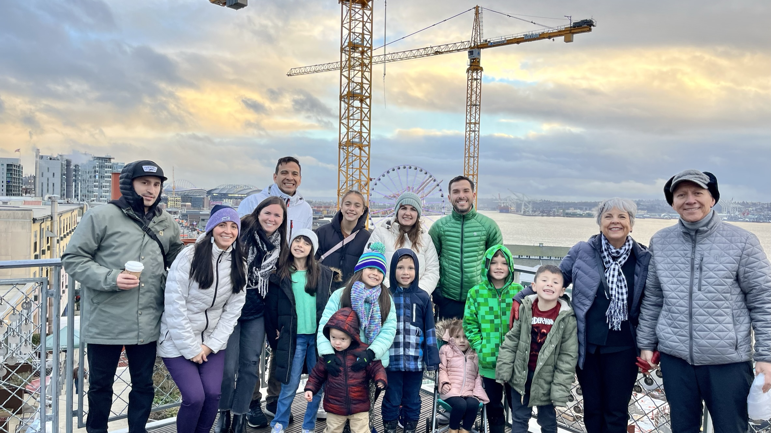

Slide 17
My Role and Goals on
Foster NMPDE Learning
Make real efforts to prepare my classes well
Present the material as best as I can.
Teach how NMPDEs apply to real world problems.
Prepare my classes, homework and exams based on the best learning approach.

Slide 18
Motivation to Learn
Love of Learning
“The more I consider what learning is, the more I see it as a sacred privilege, an act of wonder. I believe that when we are learning we feel most alive. When we are learning we feel closest to God” Russ Osguthorpe, 1996

Slide 19
My Expectation:
Your Role and Goals on
Foster NMPDE Learning
Develop a genuine desire to learn. Commit to LEARN NMPDEs.
Put aside the attitude of just filling requisites. For example,
  Study to learn not just to finish a homework or project on time
  Do more than just the the minimum to pass the class.

Slide 20
Your Role and Goals on
Foster NMPDE Learning
Take advantage of opportunities to learn. Discuss with Me and other Students in the course. Be not afraid to ask.
Test yourself frequently. Meaning try to work on your homework with no help. However, look for help when you need it and then go back to test yourself alone.
Actively participate in class. Ask questions. Put your mobile or unrelated computer or other material aside.

Slide 21
Your Role and Goals on
Foster NMPDE Learning
Be ready to go out of your comfort zone. Know this is common for college Student in Math.
Accept the fact that sometimes in some courses, you may have challenges harder than you are used to in previous courses. This is not a tragedy. Be Humble.
Do not feel embarrassed for not knowing. It is a blessing to realize that we do not know something important. It is the beginning of learning.

Slide 22
Syllabus

Slide 23
My Challenge
Love of Learners
“If we want to influence learners for good, we should not merely love to teach; we should love each person we teach.”
Teaching, No greater Call, 1999

Slide 24
Pres. G. B. Hinckley
Here we are doing what is not done in any other major university of which I am aware.
We are demonstrating that faith in the almighty can accompany and enrich scholarship in the secular. It is more than an experiment. It is an accomplishment.

Slide 25
Pres. G. B. Hinckley
Now, my brethren and sisters, the time has come for us to stand a little taller, to lift our eyes and stretch our minds to a greater comprehension and understanding of the grand millennial mission of this The Church of Jesus Christ of Latter-day Saints.
This is a season to be strong. It is a time to move forward without hesitation, knowing well the meaning, the breadth, and the importance of our mission. It is a time to do what is right regardless of the consequences that might follow.

